Slide 1
Team ANTE
Andrew Imwalle, Nick McDonough, Tuong Tran, Eli Tracy

Slide 2
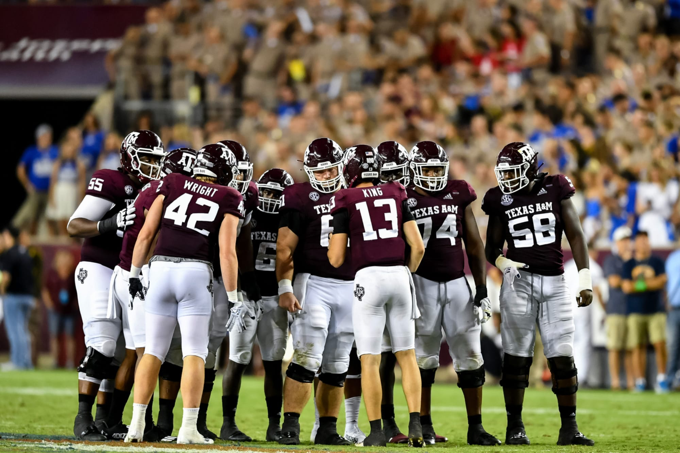

The Fighting Aggie Platform
Goal: create a user-friendly platform for Texas A&M football coaches and analysts to review and organize player data from Computer Vision tracking system.

Slide 3
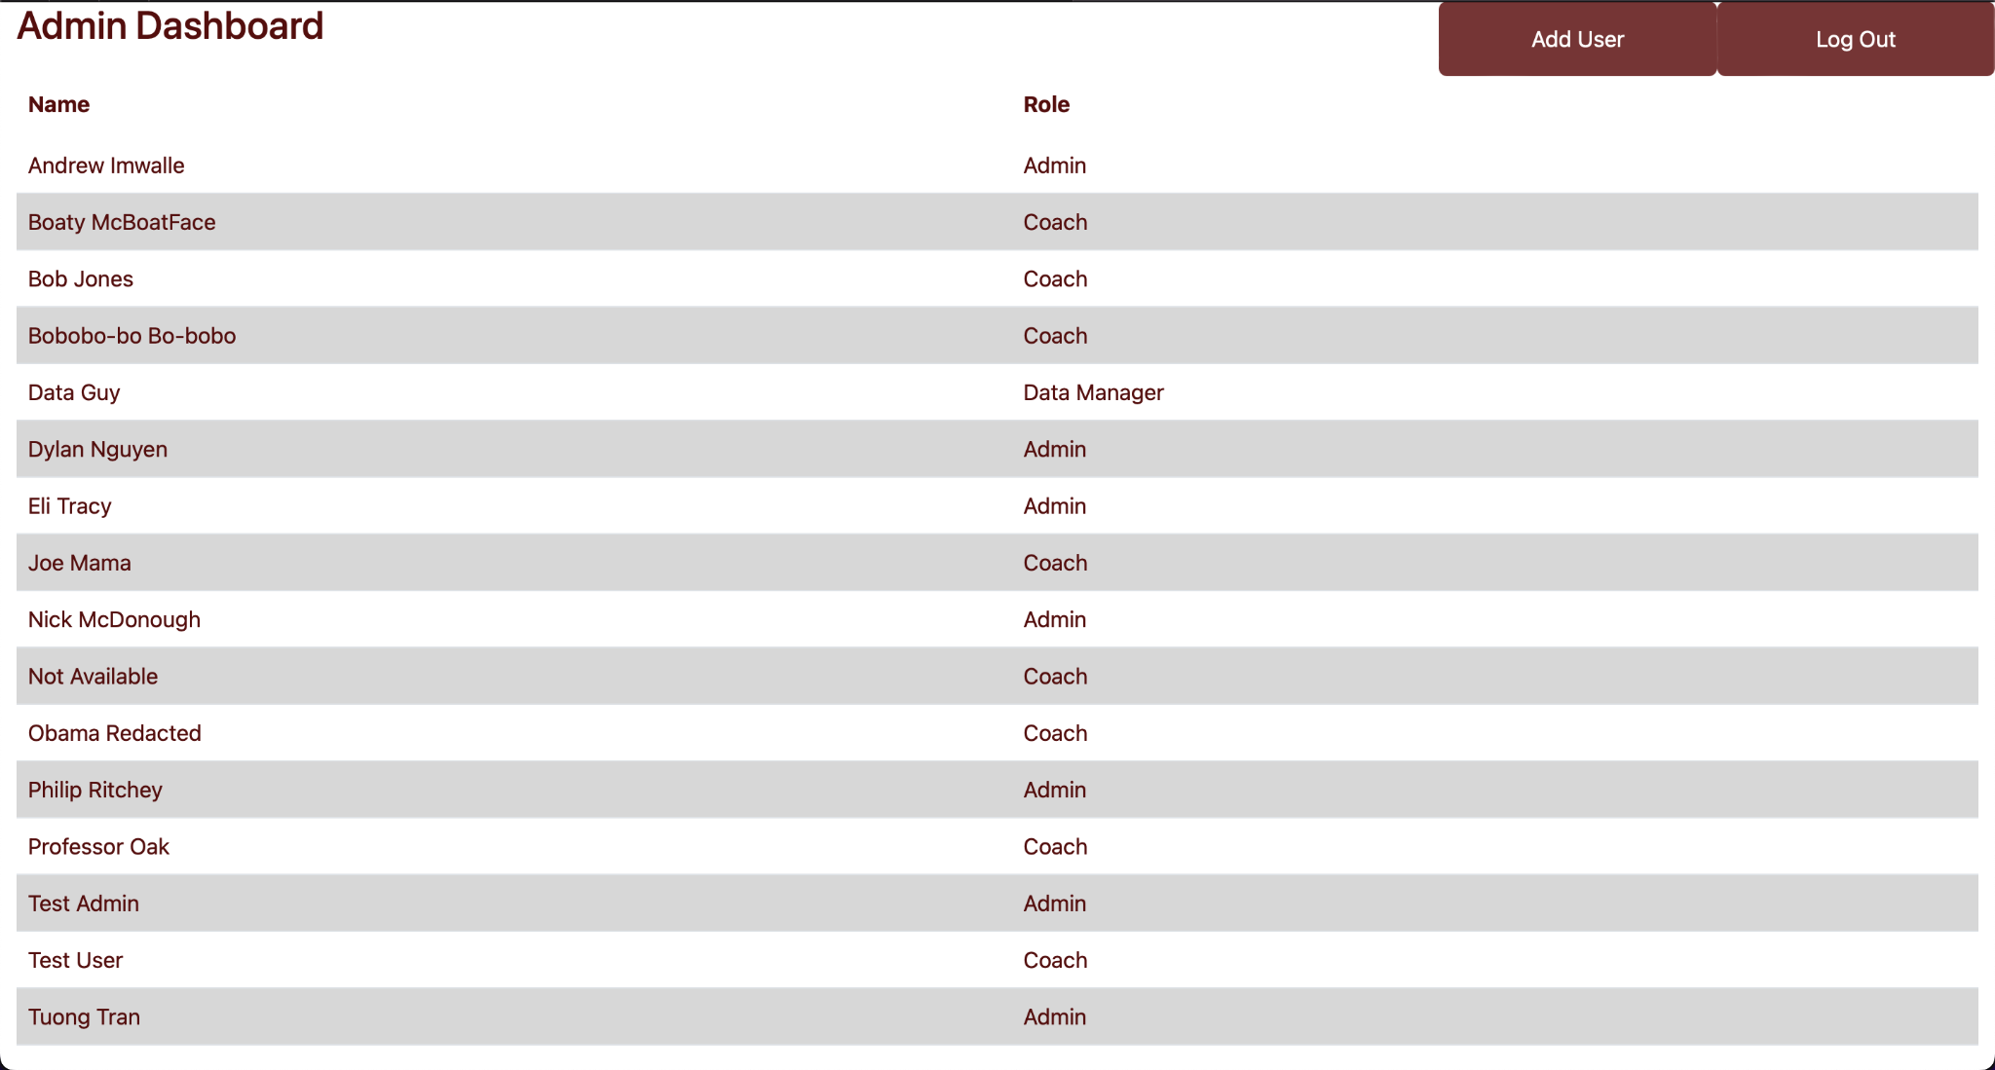
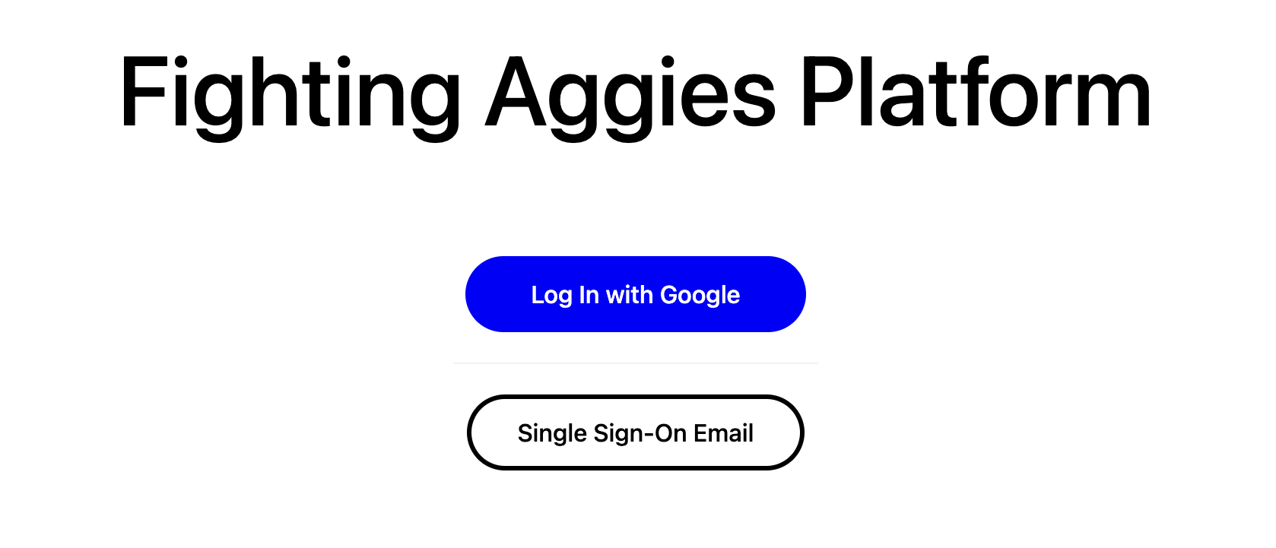
Where We Left Off
Developed admin dashboard
Sign in with Google and SSO with email

Slide 4
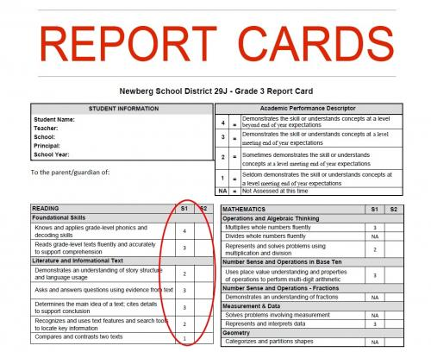

User Stories to Do After Singapore
Video upload dashboard
Analyze and visualize player, route, and play data
Create player report cards

Slide 5
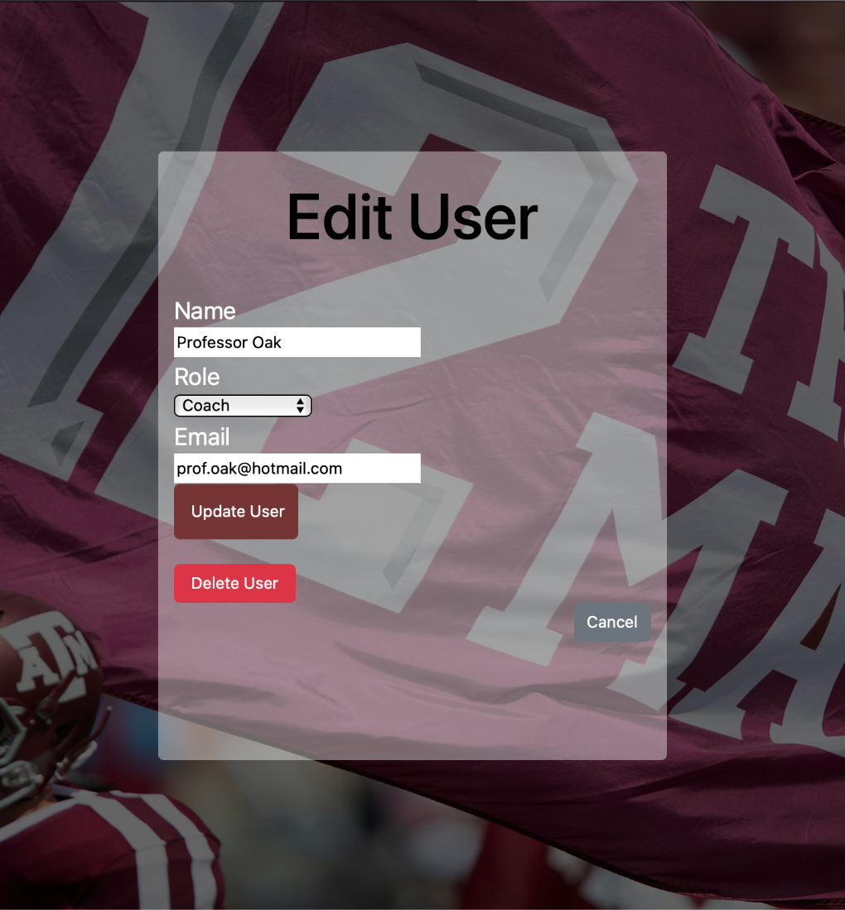
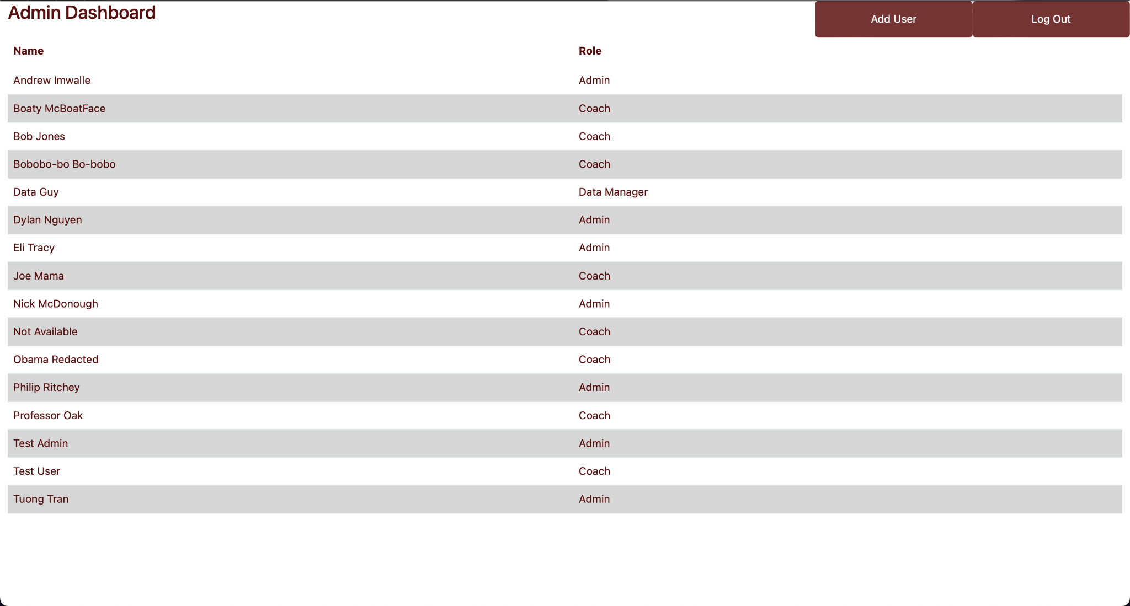
Admin Dashboard
Add/remove users
Sort users
Edit user permissions/roles

Slide 6
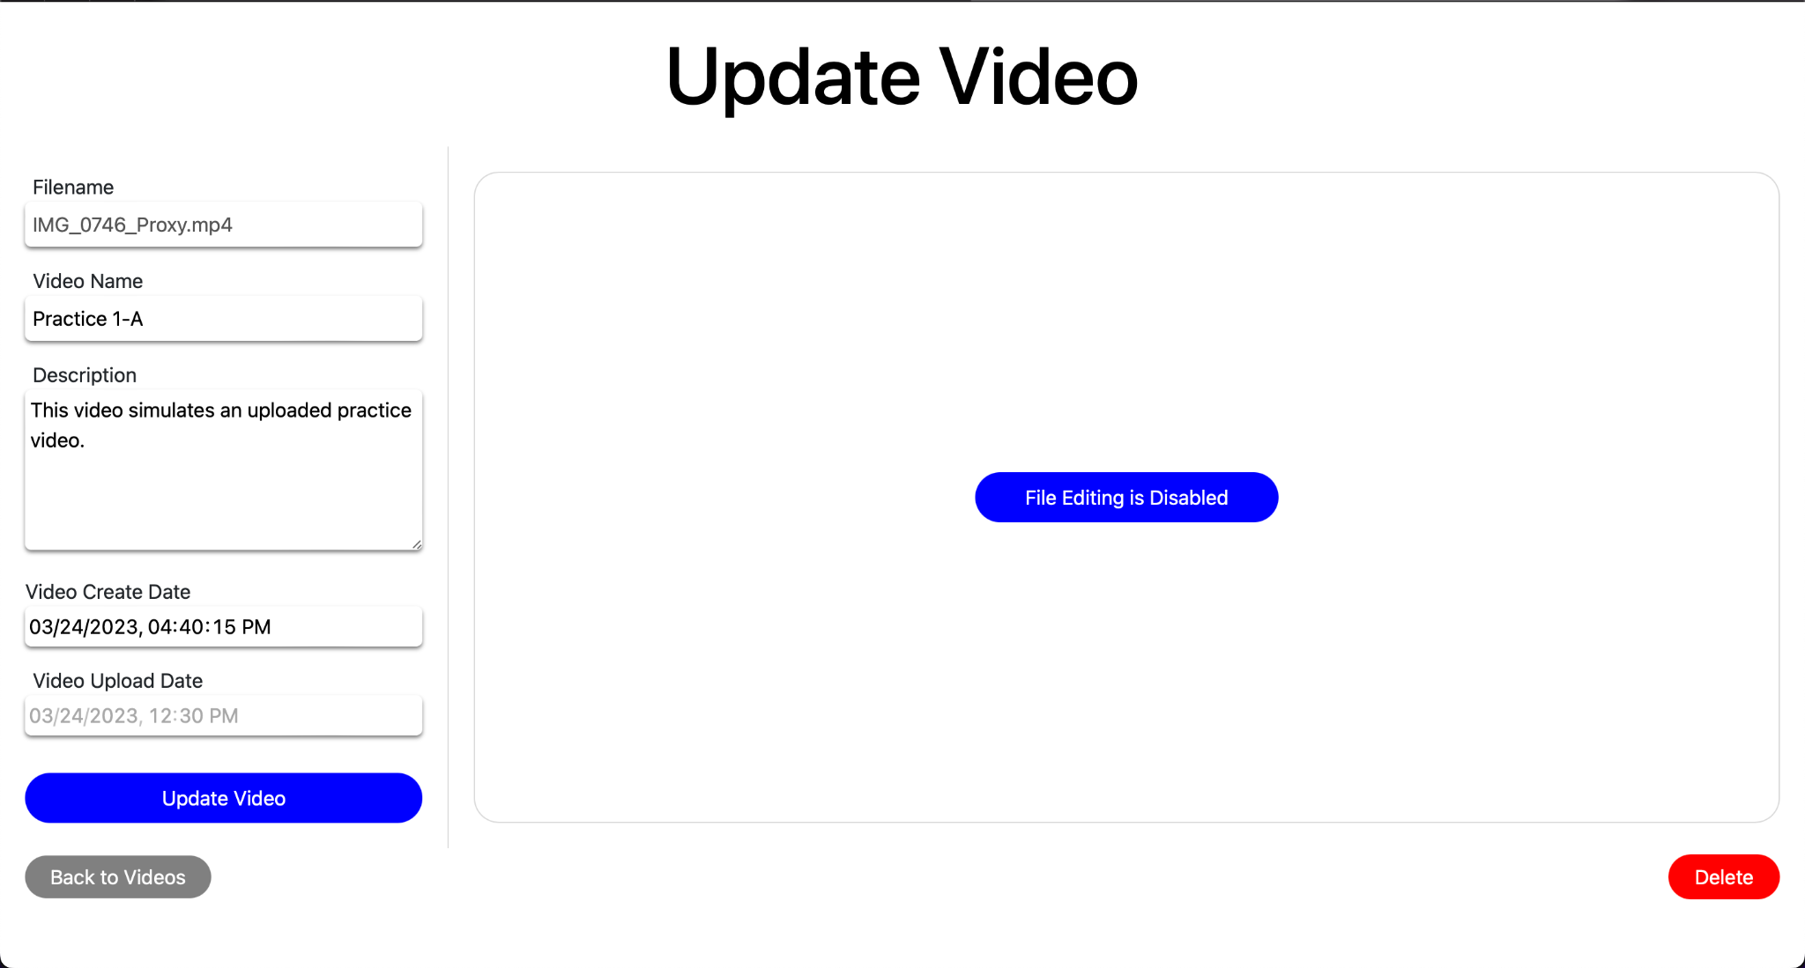
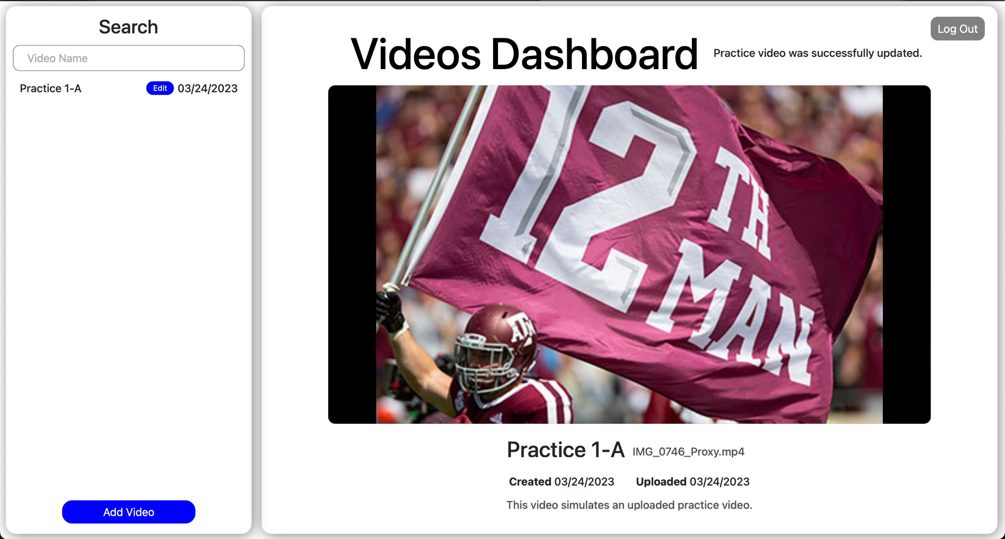
Video Uploads
Videos upload and are persistent (S3 buckets)
Videos are linked with player data
Emulates the behavior of A&M’s Computer Vision API
Adding and removing videos adds and removes the corresponding player data
Video metadata can be edited for later reference

Slide 7
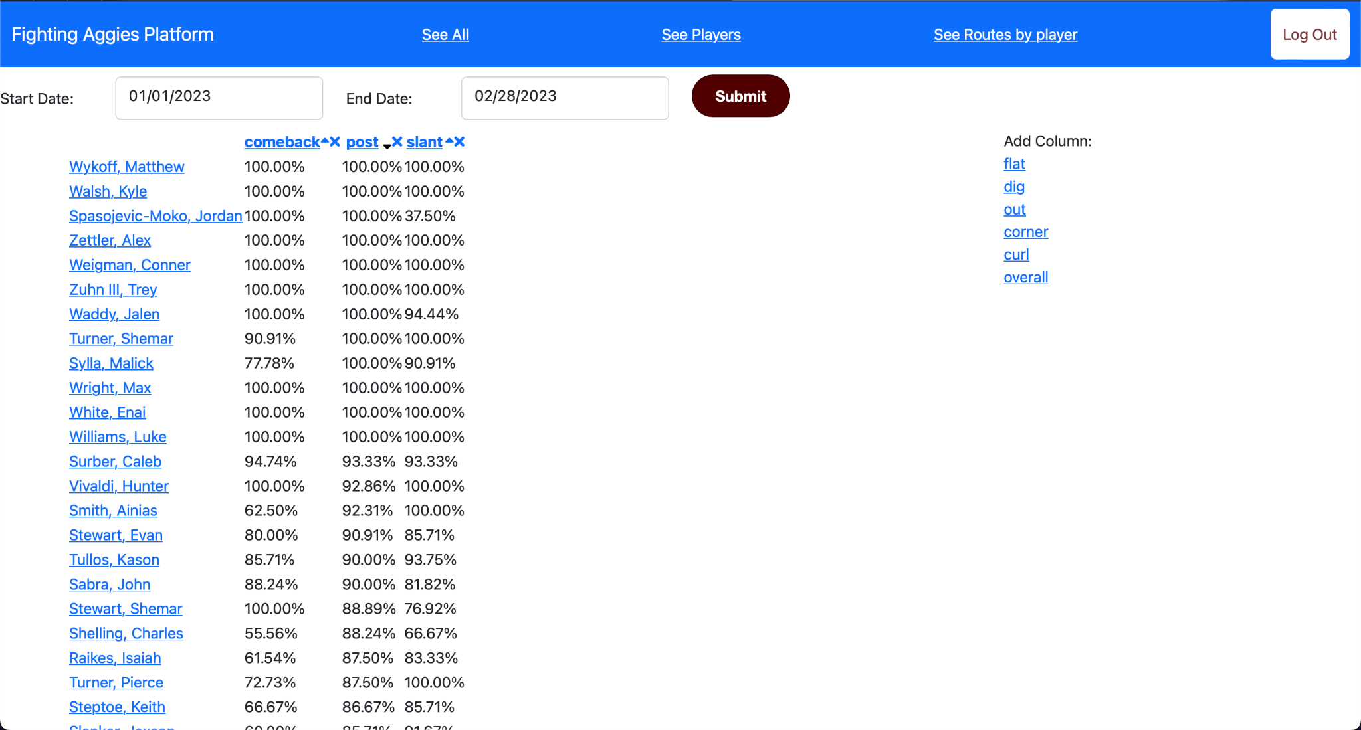
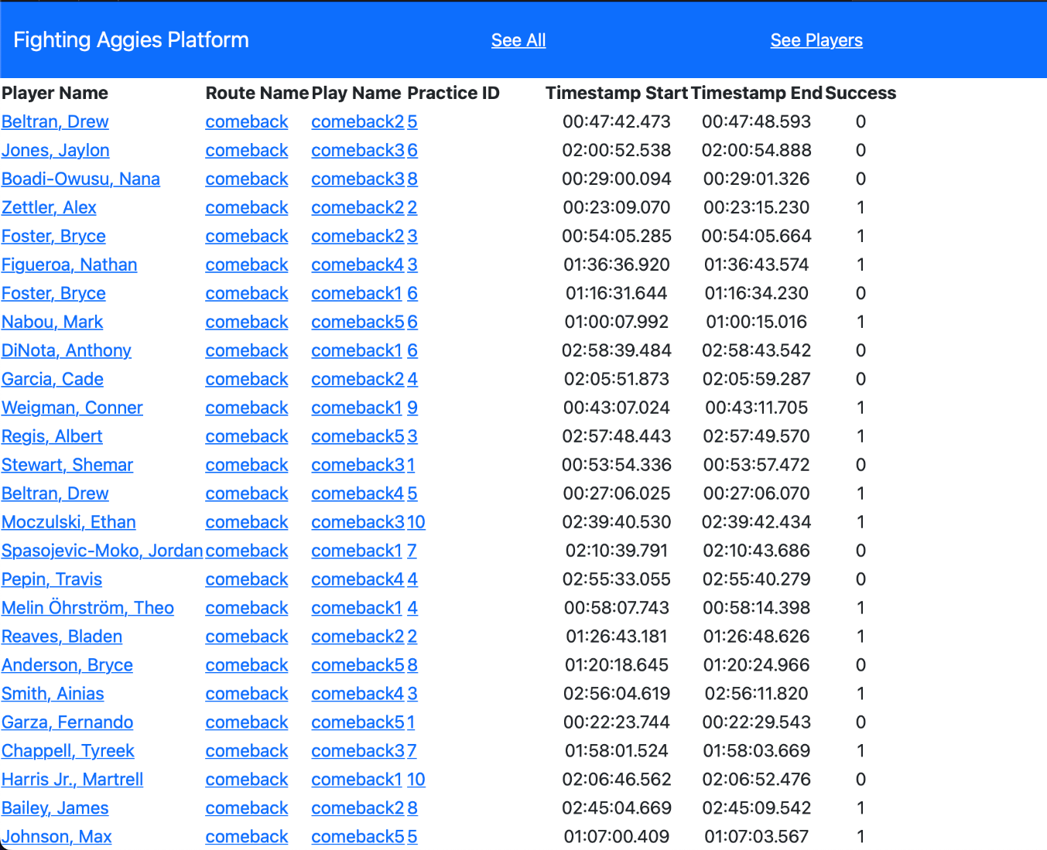
Practice Data
Data is linked to videos
Data can be analyzed and sifted through
This allows coaches to drill into specific players, routes, and plays for specific report cards

Slide 8
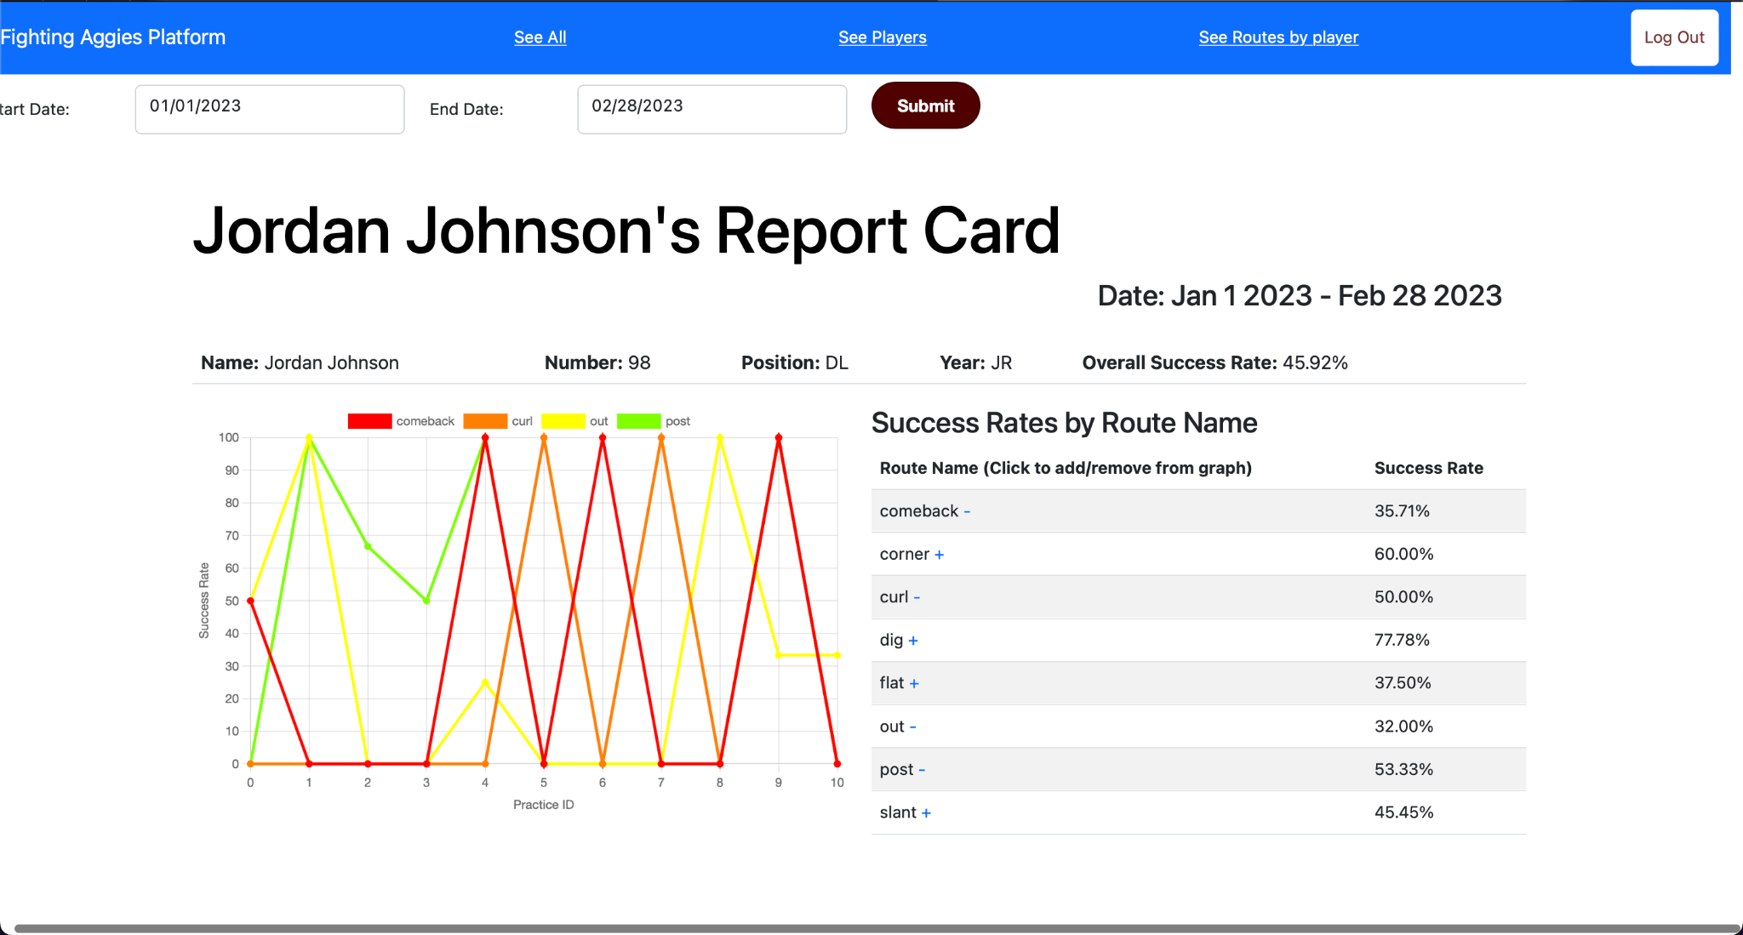
Report Cards
Specified by player
Specified by route
Allows coaches to create specialized report cards.

